Slide 1
Using De Novo Ligand Design to Discover Novel Compounds that bind to Interleukin-4 Receptor to Serve as Potential Therapeutics for Asthma
Presented by: Allison Vu

Slide 2
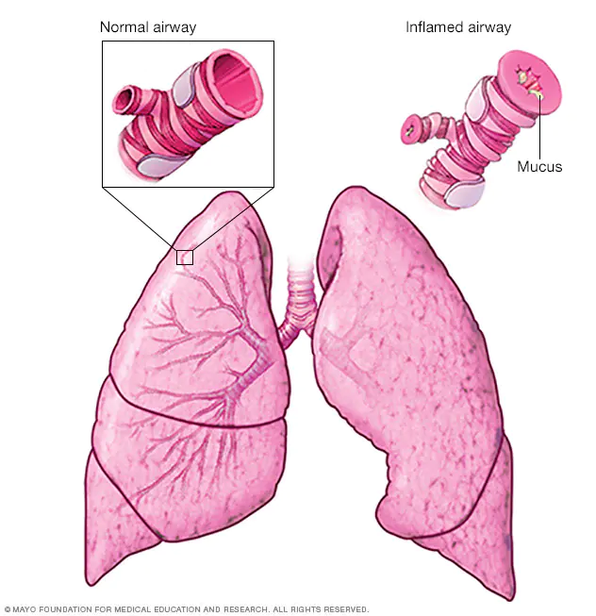
Asthma
Common in childhood but can be developed later on
Complex genetic disorder
Symptoms: shortness of breath, chest pain, wheezing
Inflamed airway of lungs
https://www.mayoclinic.org/diseases-conditions/asthma/symptoms-causes/syc-20369653

Slide 3
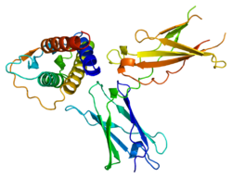
Interleukin-4 Receptor (IL-4)
IL-4: key cytokine in the development of allergic inflammation
IL-4 mediates crucial pro-inflammatory functions in asthma
Asthma is linked to polymorphisms in the IL-4 gene promoter and proteins involved in IL-4 signaling
Notes:
Induction of vascular cell adhesion molecule (VCAM)-1 on vascular endothelium

Slide 4
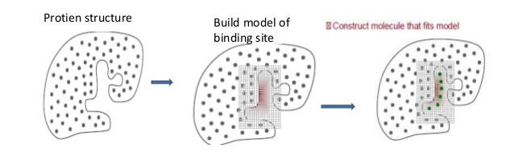
Objective
Use De Novo Ligand design to identify the novel compounds that bind to IL-4 with high affinity and are non-toxic to humans.
https://www.slideshare.net/SomasekharGupta/denovo-drug-design
Notes:
These novel compounds could serve as potential lead compounds for new drugs to treat Asthma.

Slide 5
Methods
Run De Novo Ligand design 11 times.
Estimate the binding affinities to narrow down the compounds predicted to bind with the protein.
For the designed ligands, predict the ability to be absorbed across the human intestine and predict human toxicity via the ADMET lab.
Download the 2-D structures of the compounds that have passed the GI absorption and toxicity tests.
Create 3-D structures of the successful compounds with Proteins Plus.

Slide 6
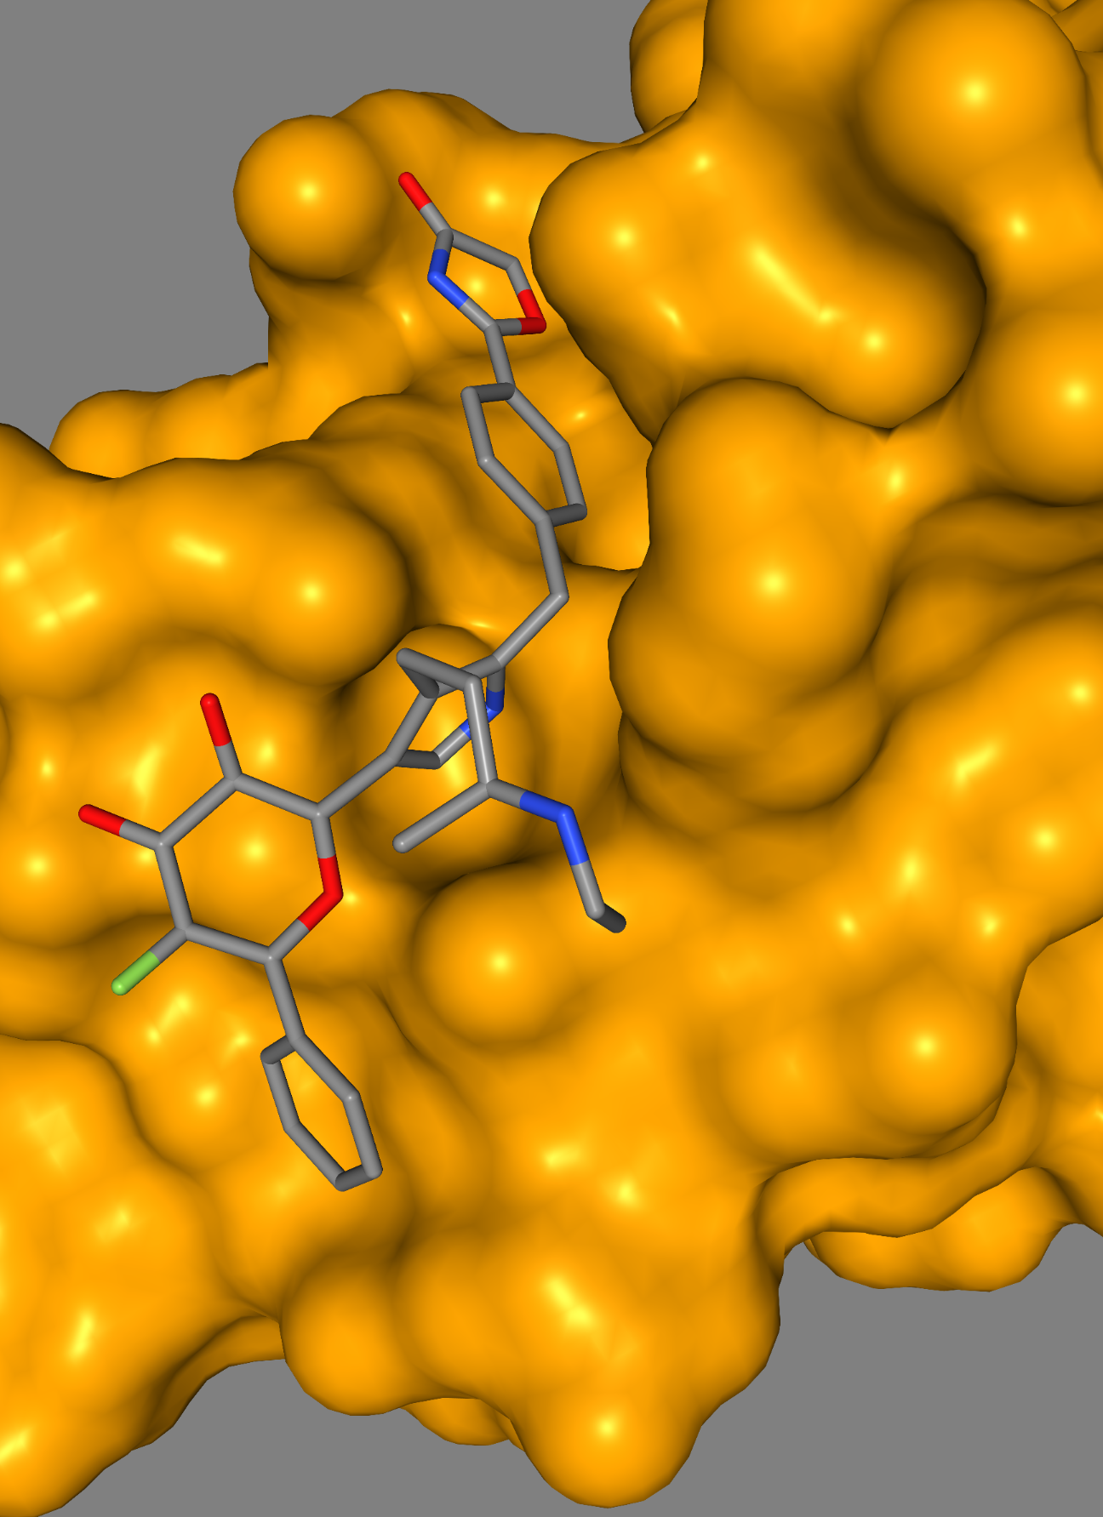
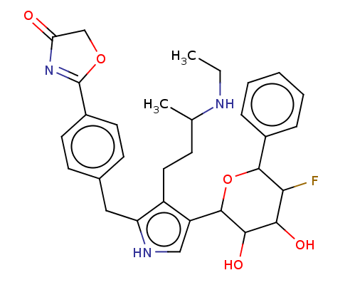
Run 6 Ligand (kD=290 nM)

Slide 7
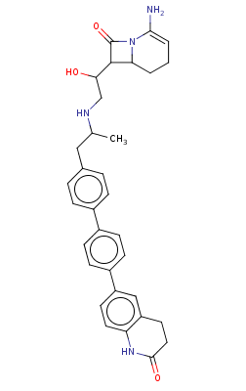
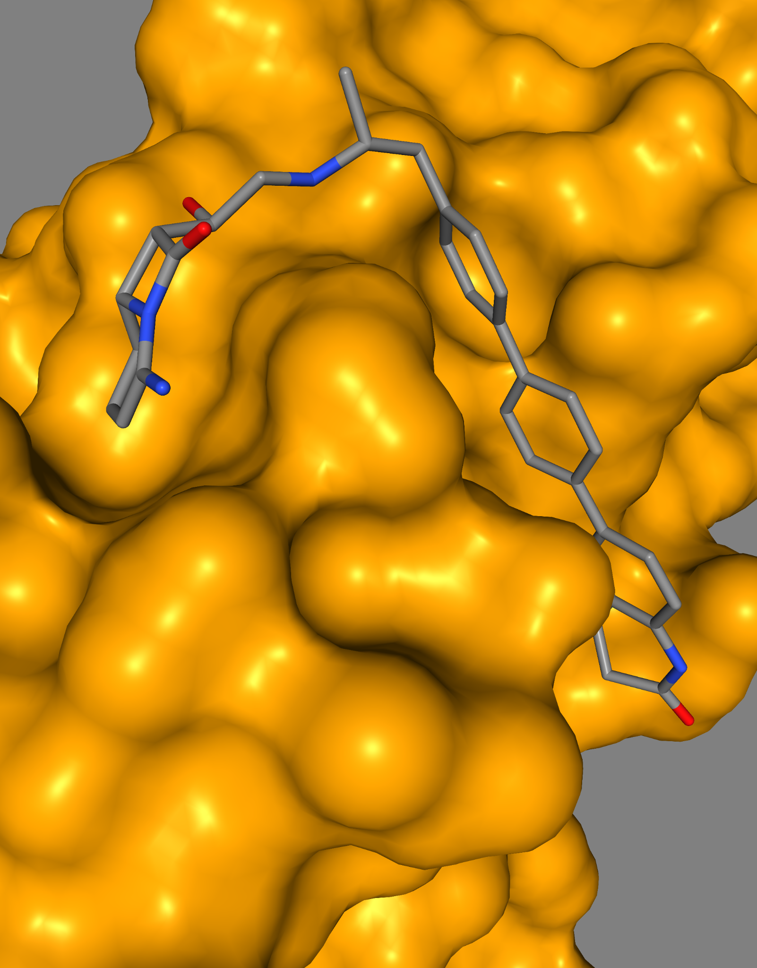
Run 8 Ligand (kD=200 nM)

Slide 8
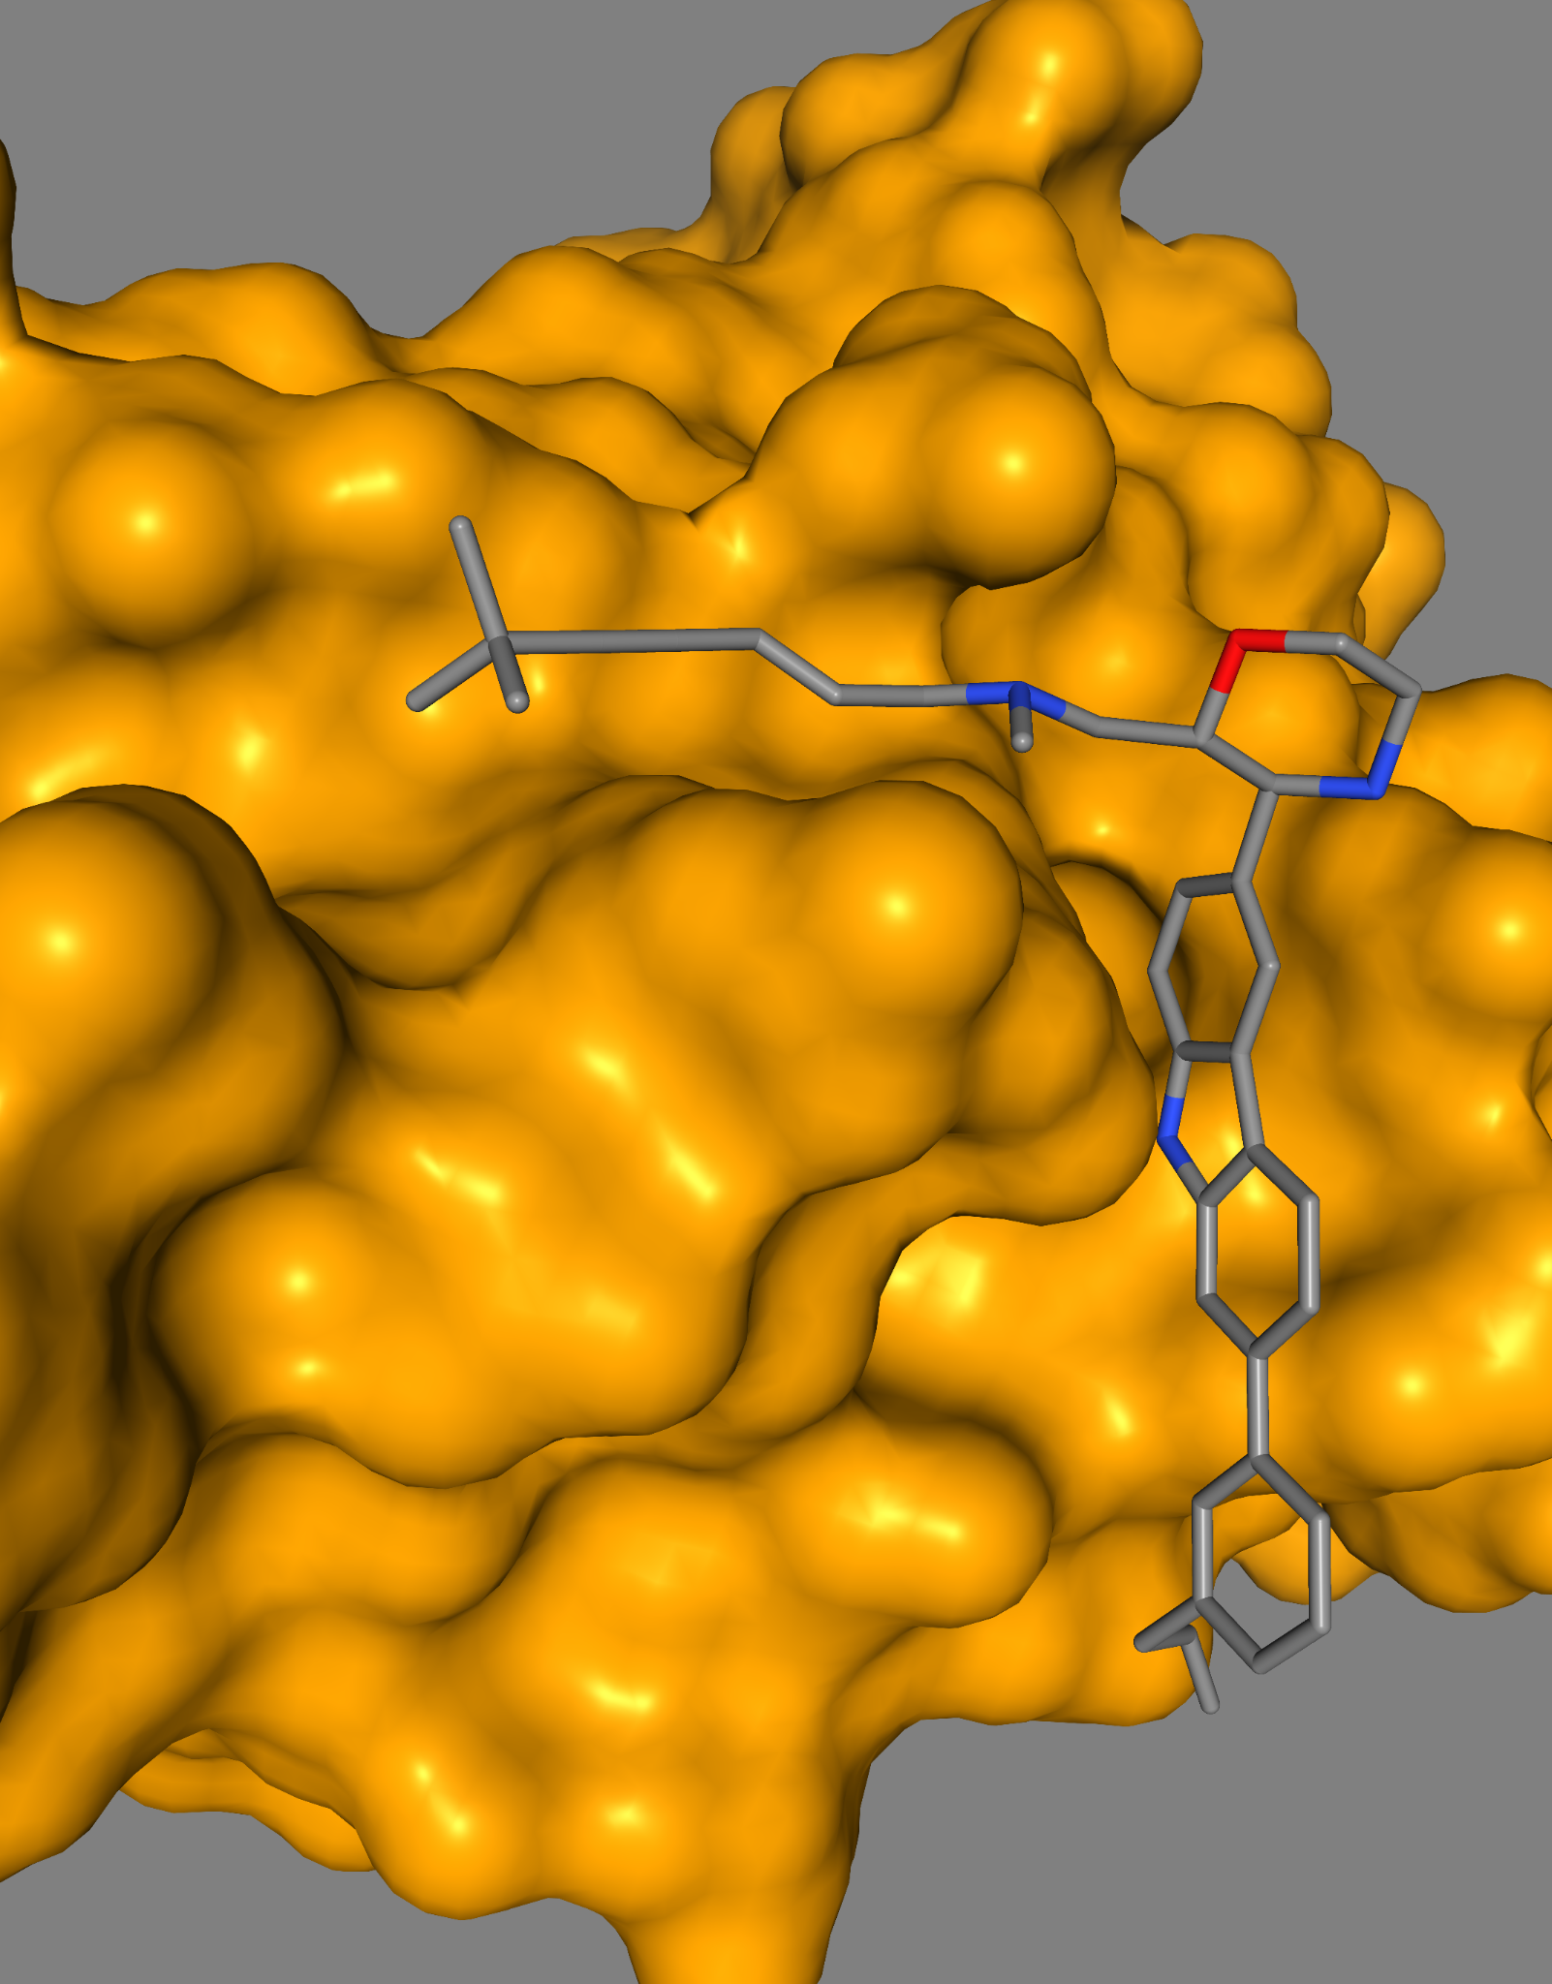
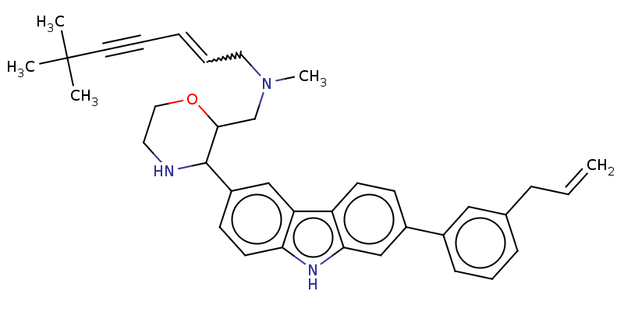
Run 11 Ligand (kD=420 nM)

Slide 9
Conclusion
Runs 6, 8, 11 all have a category 1 for Human Intestinal Absorption (HIA) and passed the human toxicity tests.
Run 8 had the strongest interaction between the ligand and protein.
All runs were over 100 nM, so they all have low binding affinity to target IL-4.
Notes:
Overall, these compounds are not strong enough to inhibit IL-4, so they may not become potential drugs to treat asthma.

Slide 10
References & Acknowledgements
https://www.ncbi.nlm.nih.gov/pmc/articles/PMC59570/
https://www.atsjournals.org/doi/full/10.1165/rcmb.2012-0080TR
Special thanks to Dr. Anderson for guiding me through this research project.

